Slide 1
ROUND 2 UNIVERSITY STUDENT CATEGORY
AITEK
AutoMate: Make Your Drive, Make Your Style
Email: aitek.automate@gmail.com
Hotline: 0703 536 941
Address: HCMUT

Slide 2
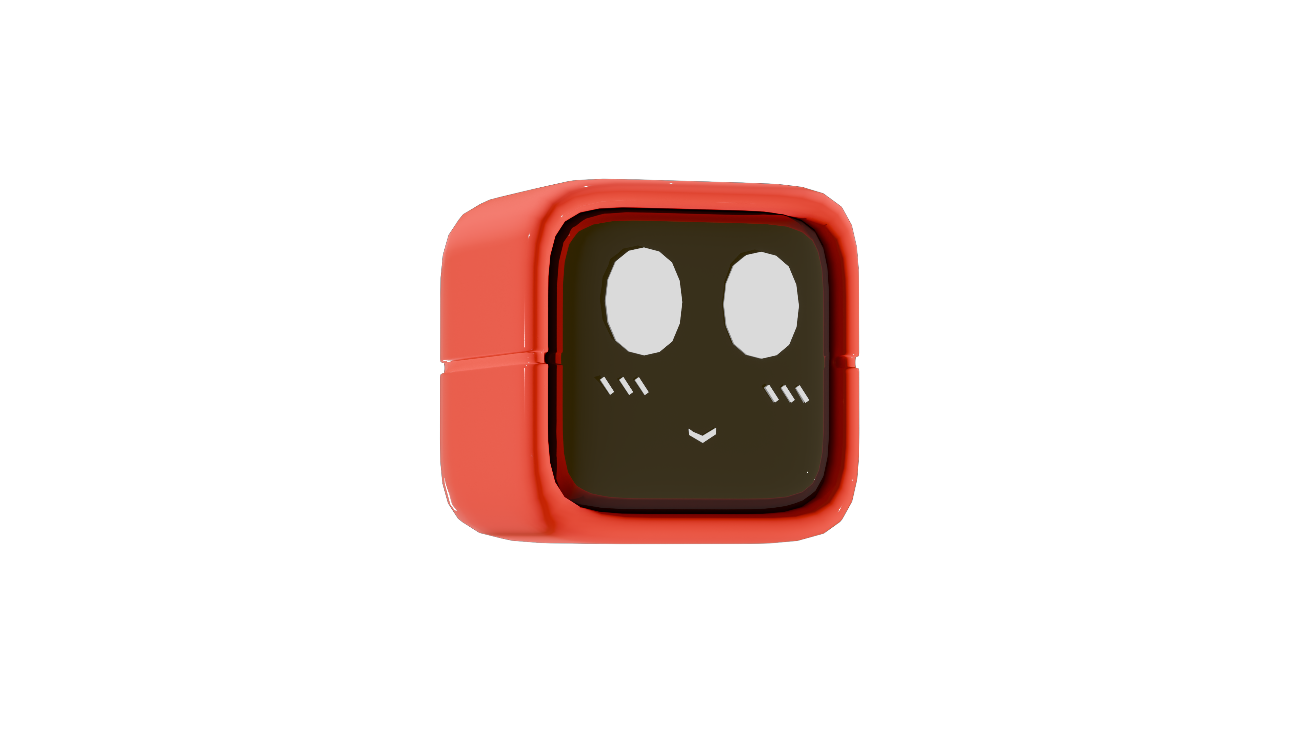


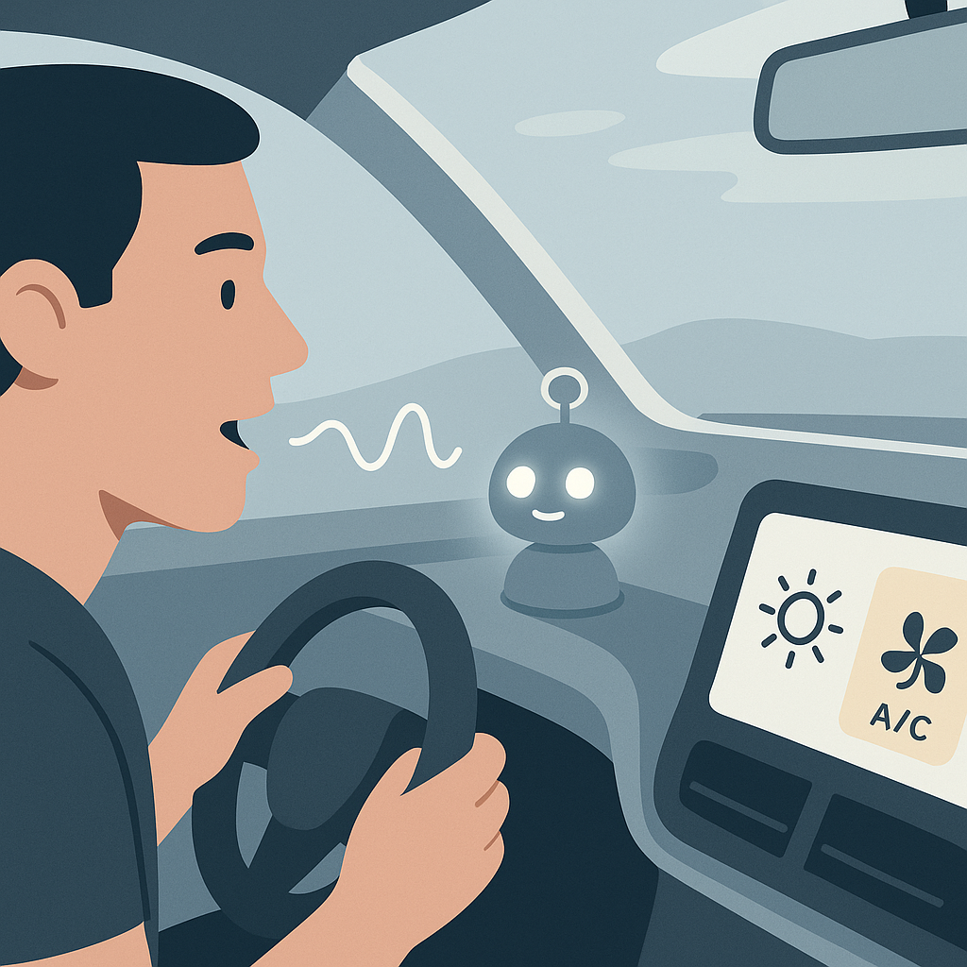
1. PROBLEM / SOLUTION
THE CHALLENGES
OUR SOLUTIONS
Complex in car-system
=> High distraction and safety risk
Enhances Safety: Focused, Hands-free control
MOGI
100% Offline Reliability: Works anytime, anywhere
Online assistants limited by unreliable connectivity
Enables Law Compliance & Safer Habits
Phone Use Penalties: Legal & Financial Risks
(Decrees 100/2019 & 123/2021 & 168/2024)
=> Positive Social Impact: Safer Roads, Greater Tech Accessibility

Slide 3
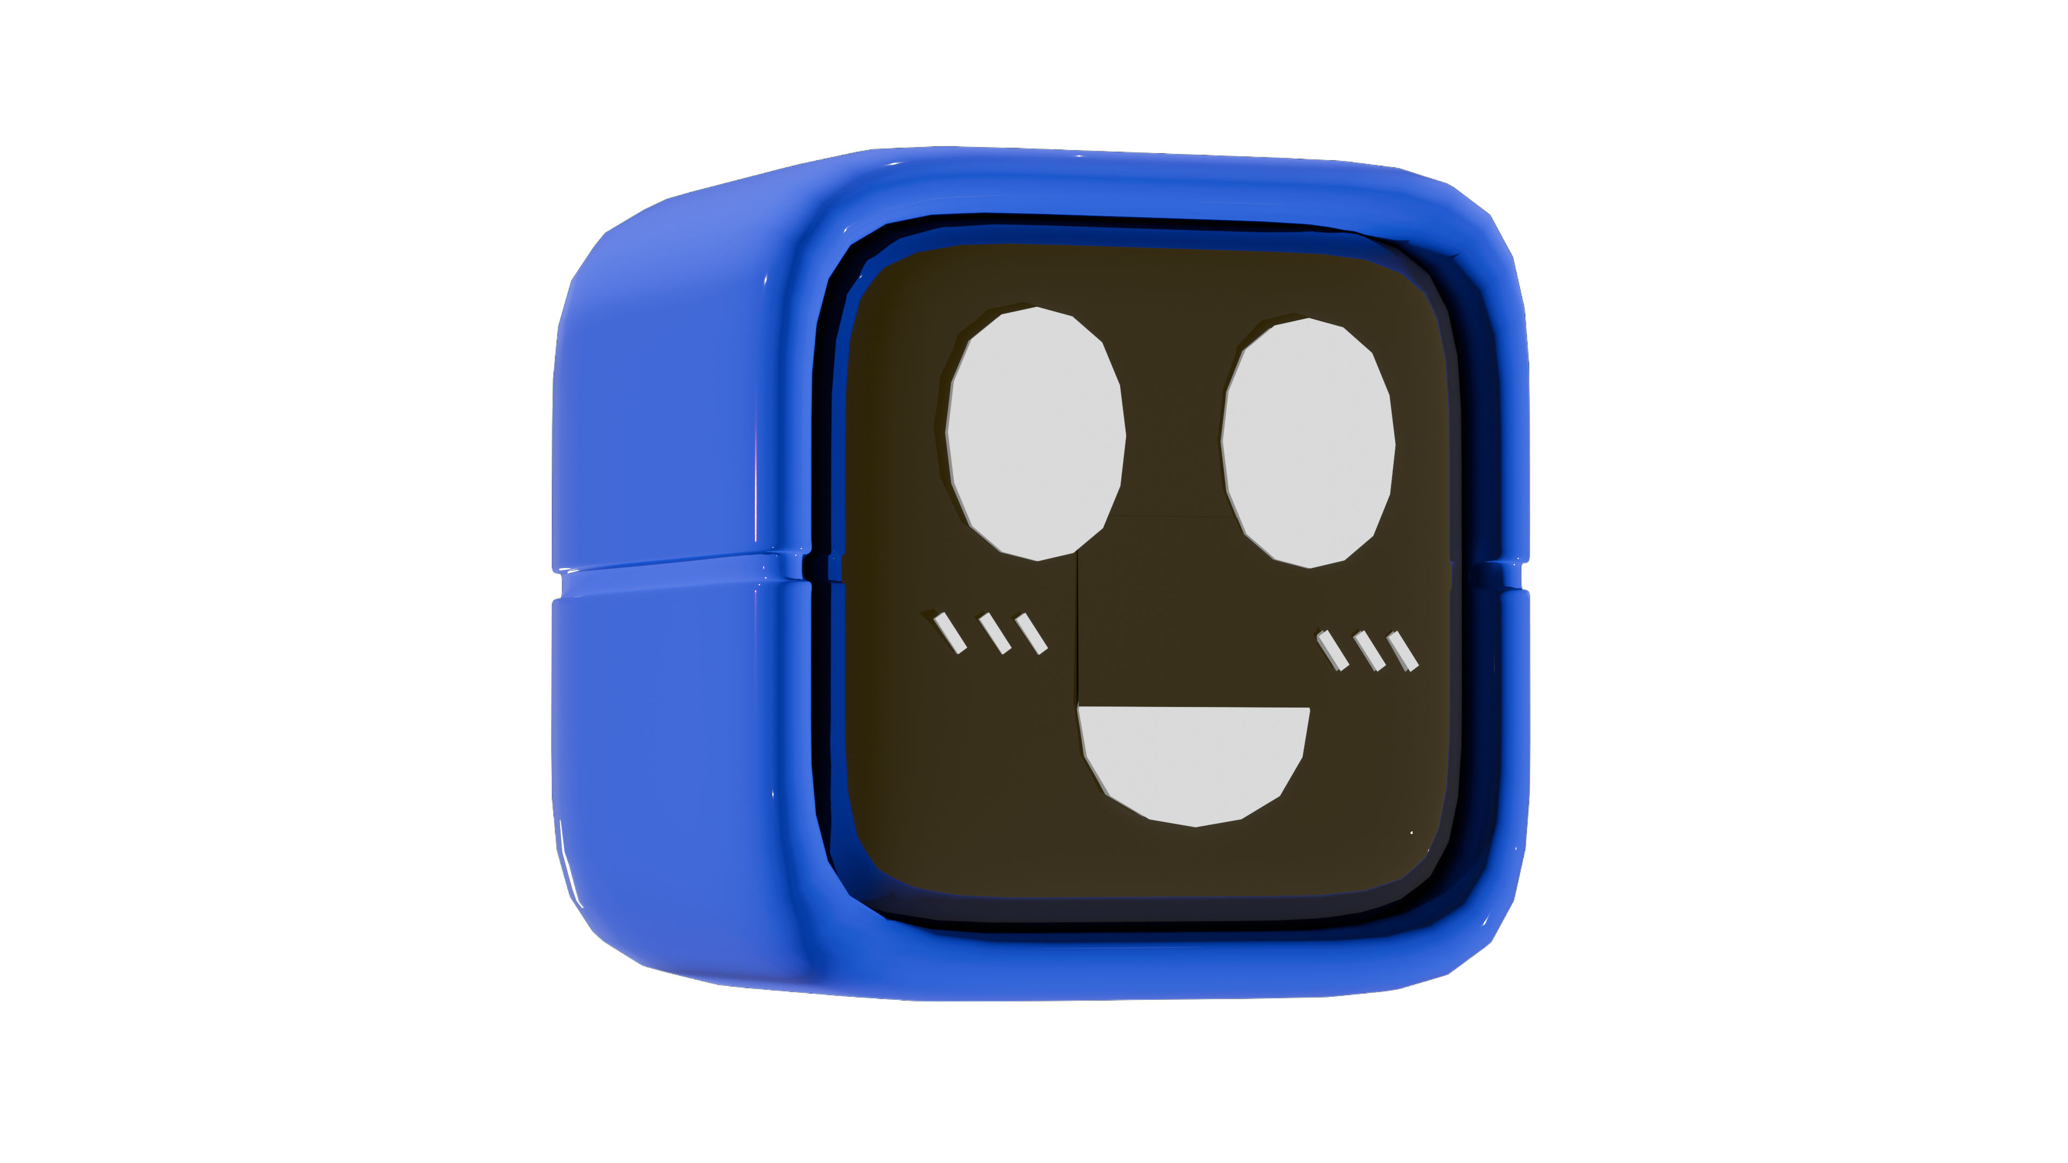
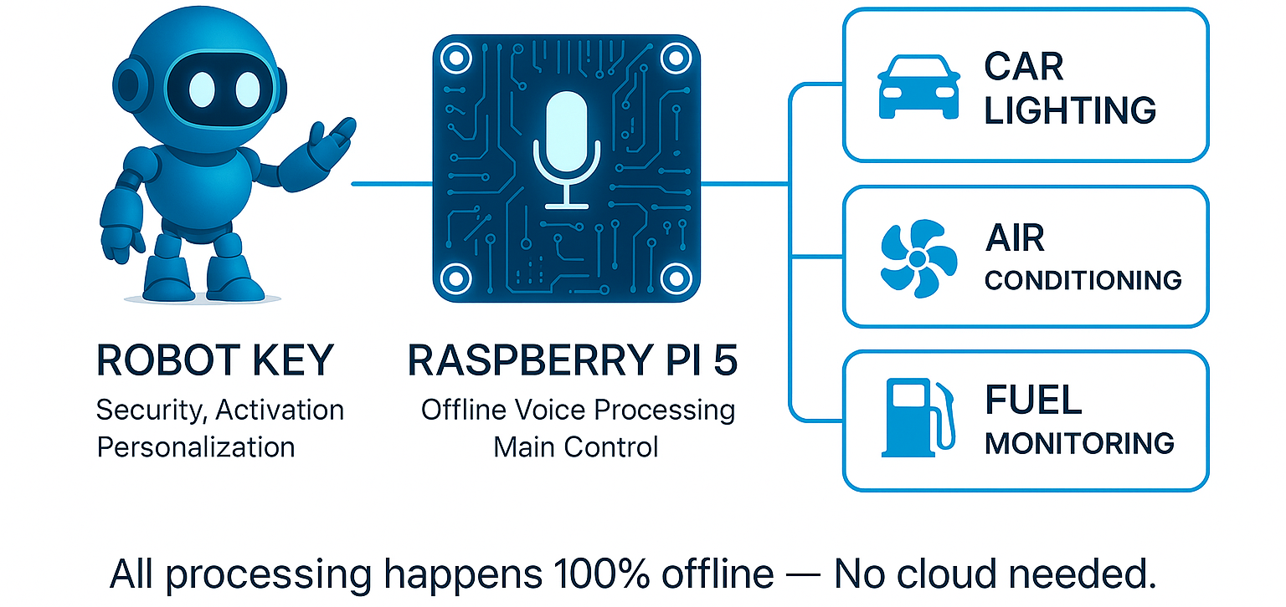
2. INNOVATION
How MOGI’s work?

Slide 4
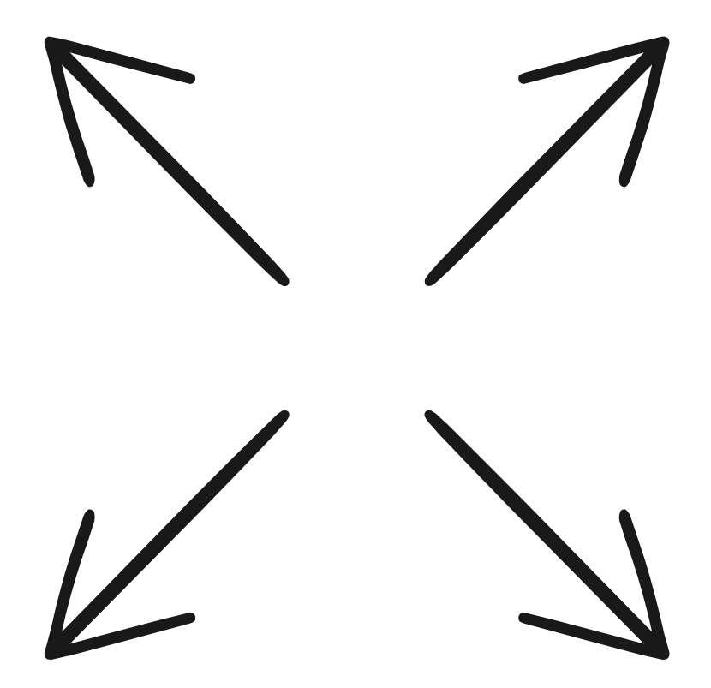
2. INNOVATION
100% Offline Voice Control
Unique “Robot Key” Interface
No internet needed
Work anywhere
=> Enhance Reliability & Better Accessibility
Physical Robot Key
Engaging Interaction
Unique Activation
MOGI
Deep Hardware Integration
Smart Retrofit
Bring Smart Tech to any cars
Affordable upgrade path
Direct Hardware Control (CAN Bus)
Beyond App-Level Control
Embedded Vehicle Control

Slide 5
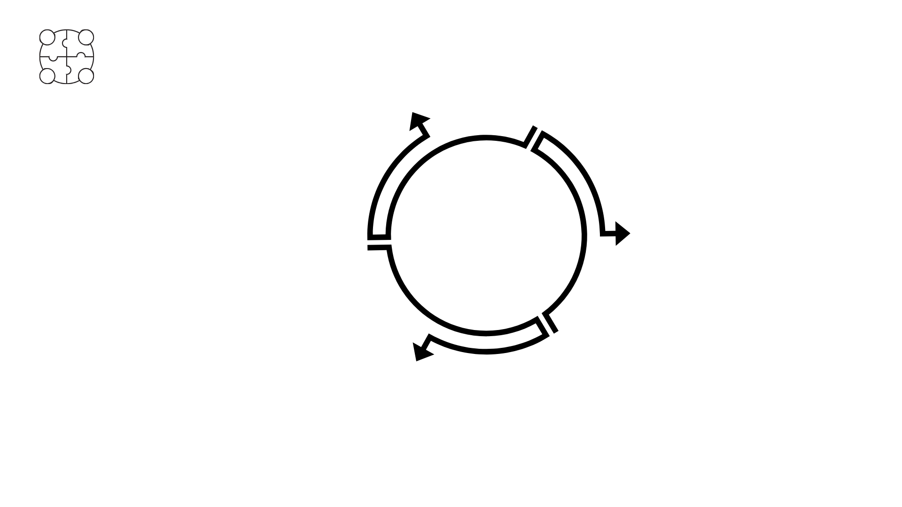

3. MARKET FEASIBILITY
Market Needs
Target Market
Urgent Need for Enhanced Driving Safety
Demand for Reliable Offline Solutions
Desire for Simplified In-car Interaction
Tech-Savvy Urban Drivers
Connectivity-Challenged Commuters
Vehicle Retrofit Seekers
Ride-Hailing Professionals
MOGI
TAM ~ 580M $
Supportive Trends
Rising Safety Consciousness
Smart Car Adoption & Personalization
Growth of Edge AI & Offline Technology
SAM ~ 71M $
SOM
2%

Slide 6
3. MARKET FEASIBILITY
S
STRENGTHS
• Stable offline voice
• Friendly, customizable robot-like design.
• Broad compatibility (CAN/I2C/UART).
• Modular hardware for easy mainteinance.
• Compacrt, aesthetic form enhances interior experience
W
WEAKNESS
• High production cost at small scale.
• Limited voice command vocabulary (early stage).
• Installation may require wiring expertise.
• UX needs ongoing refinement
O
OPPORTUNITIES
• Growing ride-hailing and rental markets.
• Supportive policies for local tech startups.
• Rising interest in traffic safety and smart mobility.
• Potential for education /training partnerships.
T
THREATS
• User preference for built-in assistants (Google, Siri).
• Chip and microcontroller supply chain risks.
• Skepticism toward aftermarket electronics.
• Risk of copycats after product launch.

Slide 7


3. MARKET FEASIBILITY
Product | CarPlay / Android Auto | Cerence / Sensory | In-car robots | MOGI
Offline Functionality | ✗ | ✗ | ✗
Hardware Control (e.g., lights, AC) | ✗
Smartphone
Emotional & Decorative | ✗ | ✗ | ✓
Navigation Ability
Affordability (≤ 3M VND) | ✓ | ✗ | ✗ | ✓
Customization & DIY Support | ✗ | ✗ | ✓ | ✓
Target Market | Smartphone users | Premium vehicle manufacturers | High-end electric vehicle users | Mass-market drivers, youth, service drivers

Slide 8






3. MARKET FEASIBILITY
High price
Competitive matrix
Low quality
High quality
Low price

Slide 9
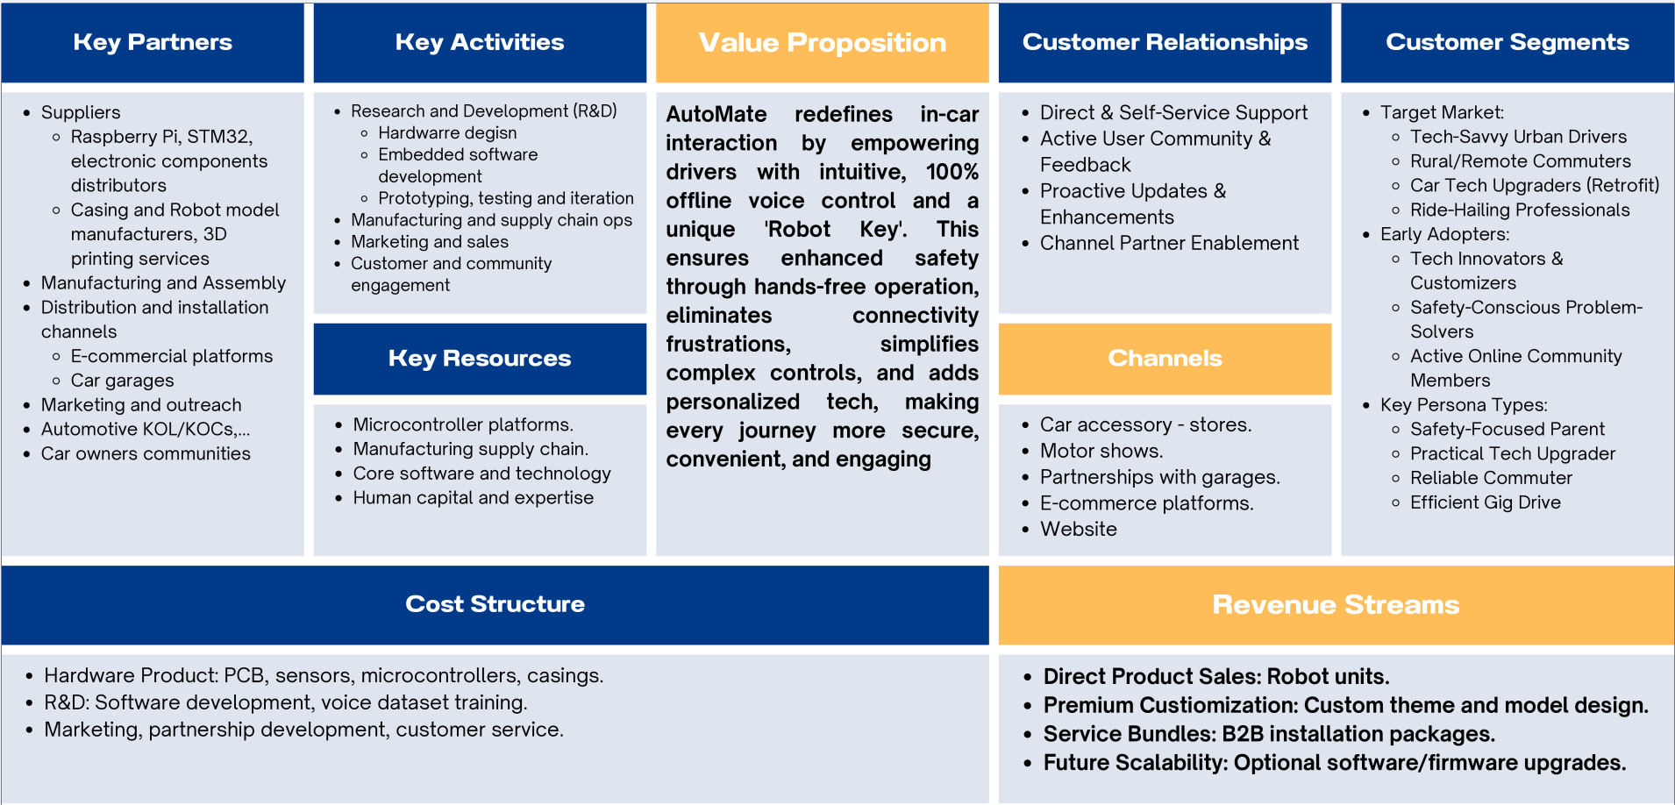
4. BUSSINESS MODEL

Slide 10
4. BUSSINESS MODEL
PRICE LIST
MOGI KIT Complete smart assistant system | 2,999,000
Robot Key – Pre-designed Ready-made models with themed designs | 249,000
Robot Key – Custom Design Personalized design service (based on user requests) | 799,000 – 999,000
Software Upgrade New voice packs, advanced commands (one-time purchase) | 349,000
Currency unit: VND

Slide 11
4. BUSSINESS MODEL
Profit Contribution | Pessimistic | Base-Case | Optimistic
Profit from Main Product | 1,199,600 | 1,199,600 | 1,199,600
Expected Profit from Robot Key | 34,860 | 69,720 | 95,865
Expected Profit from Design Service | 11,186 | 27,965 | 44,744
Expected Profit from Software | 33,155 | 66,310 | 99,465
TOTAL LTV (Gross Profit) | 1,278,801 | 1,363,595 | 1,439,674
Estimated Lifetime Value of an Acquired Customer - LTV
Currency unit: VND

Slide 12
4. BUSSINESS MODEL
COCA (Year 1) 400,000 VND/customer
In line with Vietnam’s smart device & automotive accessory market, where typical first-year COCA ranges from 300,000–700,000 VND/customer (Do Ventures 2022, Statista IoT Market Data)
LTV range Estimated to be between
~VND 1.28 million and ~VND 1.44 million
LTV/COCA ratio Ranges from 3.2 to 3.6
An LTV/COCA ratio greater than 3

Slide 13




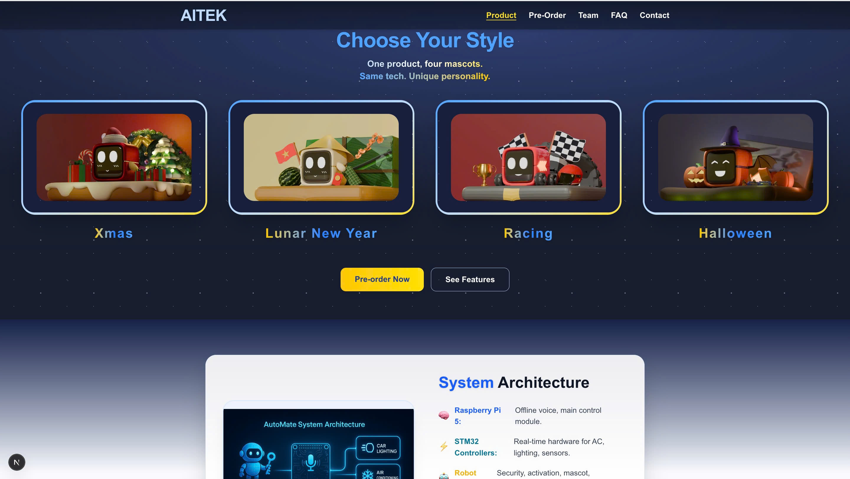

4. BUSSINESS MODEL
TRADITIONAL CHANNEL
CONTEMPORARY
E-commerce
platforms
Car accessory - stores
Motor shows
Website
Partnerships garages

Slide 14

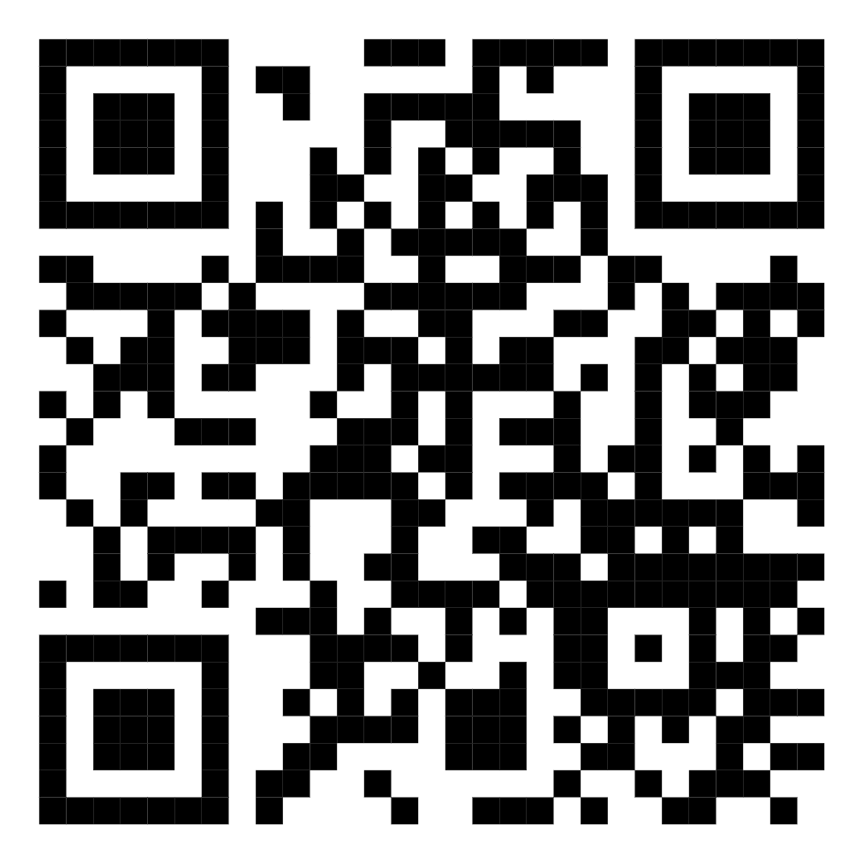
4. BUSSINESS MODEL
Scan this QR code to access our website, AITEK!

Slide 15

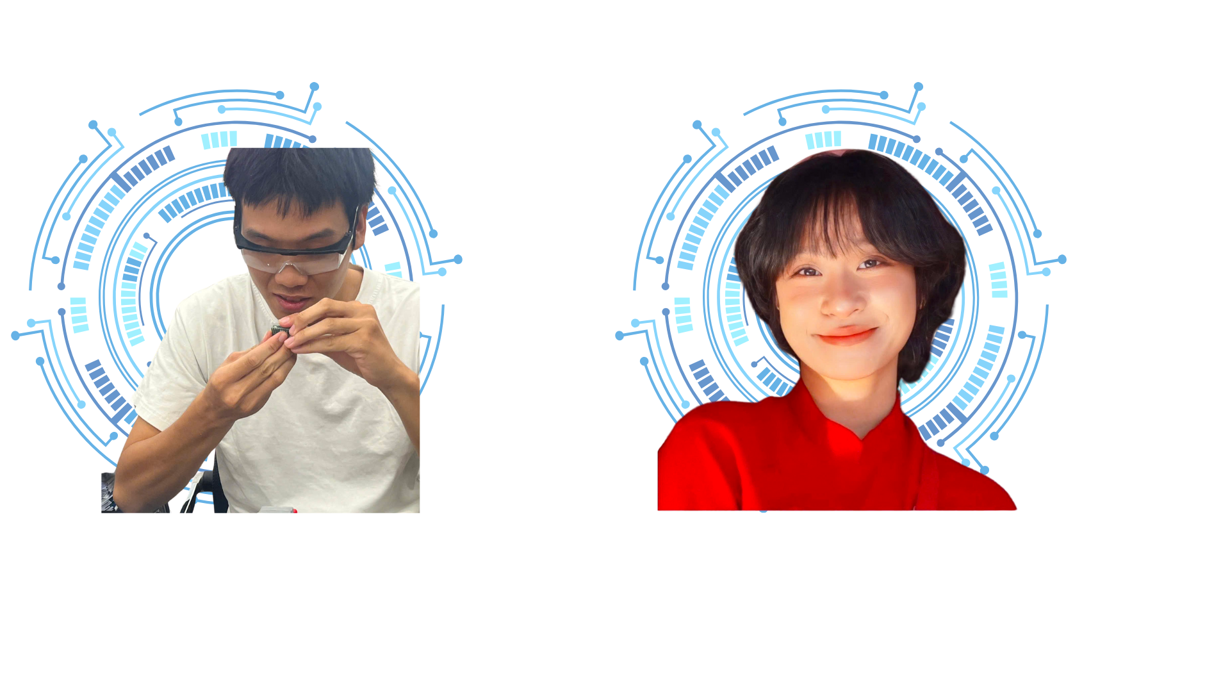

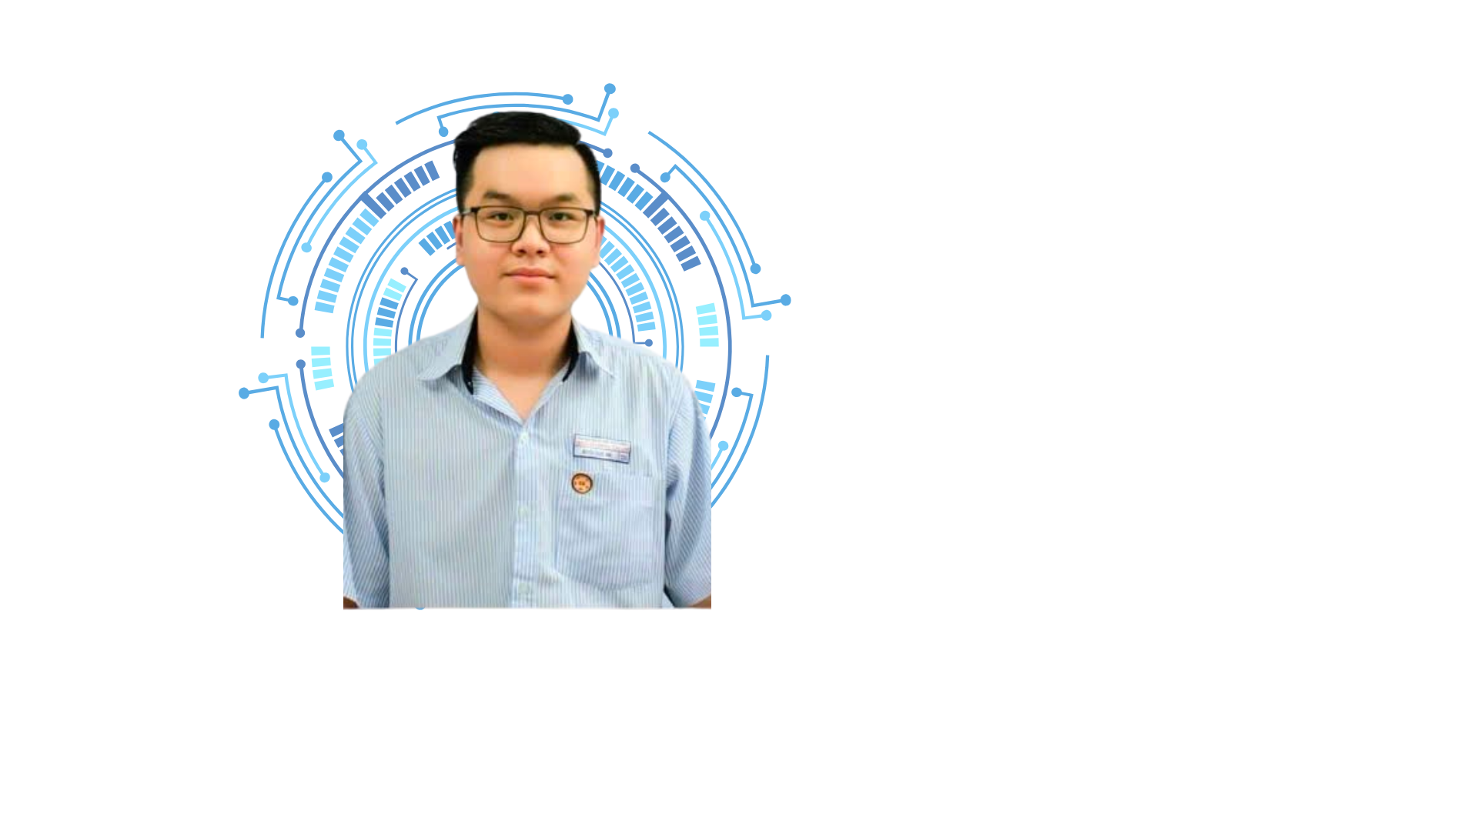
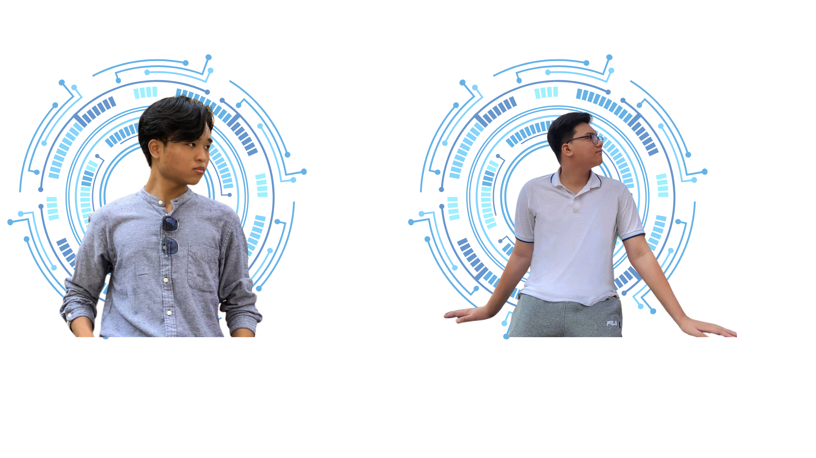
5. TEAM & ADVIDORS
AITEK: Dedicated Automotive Engineering Students from HCMUT
Team Leader: Tieu Chi
Embedded Software Development
Vehicle Interface Integration
Thuy Tien
Hardware Developer
Minh Duy
Software Developer
Mentor: Mr. P.T Dang Quang
Lecturer at the Faculty of Transportation
Guidance: Transportation Engineering & Electronic Field
Nang Tri
Team Spokesperson
Tien Dung
Market Analyst

